Slide 1


Word Search Puzzle Generator

Slide 2

Introduction
Word search puzzles test vocabulary and pattern recognition.
This project generates custom puzzles using C programming.
Developed by 4 team members under CSE115 curriculum.

Slide 3
Problem Statement & Significance
Design a word search puzzle from user inputs.
Words can appear in 8 directions, no overlaps allowed.
Promotes logic-building, randomization, and boundary checking.
Great educational and recreational value.

Slide 4



Methodology Overview
1. Grid Initialization: 2D array with '.' as placeholders.
2. Random Word Placement: Choose direction and starting cell.
3. Validity Check: Prevents out-of-bound or overlapping.
4. Fill Empty Spaces: Random capital letters.

Slide 5
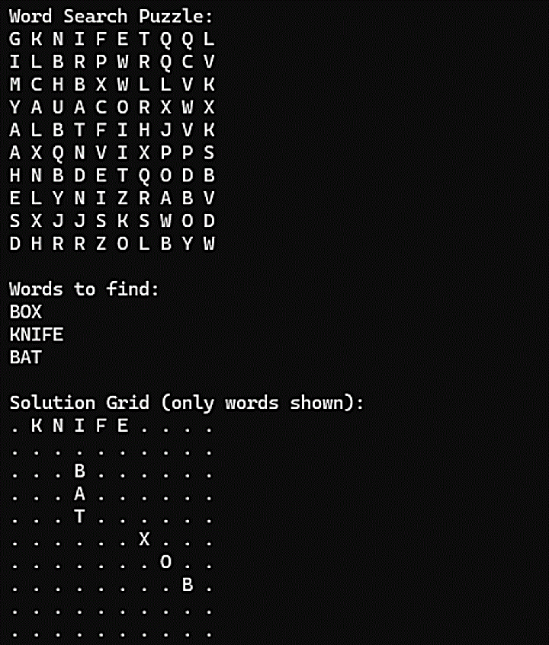
Sample

Slide 6
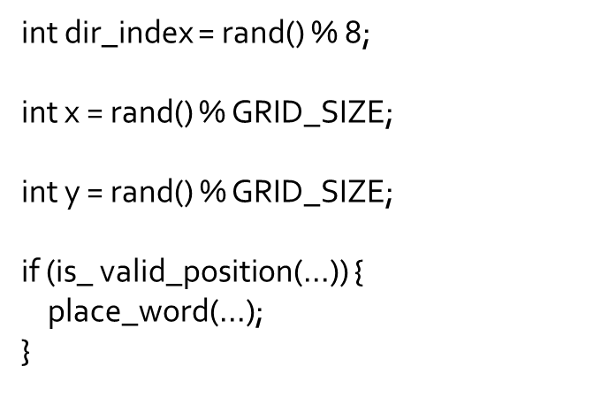
Random Word Placement (Code)

Slide 7


Implementation & Testing

Slide 8
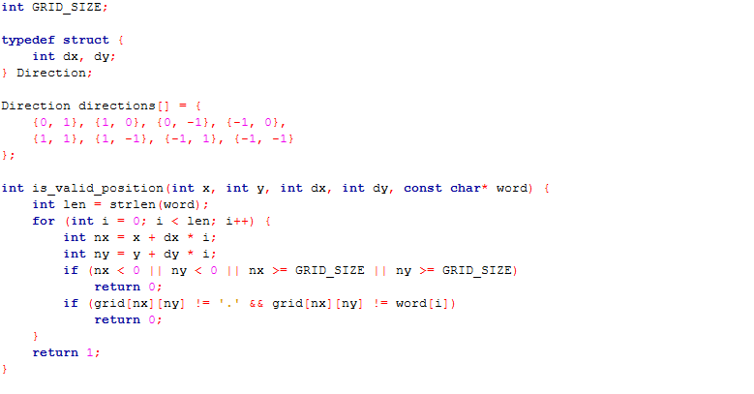
Functions
FUNCTIONS

Slide 9
Results & Limitations
All words placed successfully with retry logic.
Performance good for 15x15 grid, <0.5s runtime.
Limitations: Console-based, no GUI, relies on randomization.

Slide 10

Future Enhancements
Add GUI using SDL or GTK.
Support themed puzzles and export to PDF.
Reduce randomness dependency with smarter algorithms.
Introduce levels of difficulty.

Slide 11
Conclusion
Demonstrates C programming concepts clearly.
Dynamic, educational, and fun for users.
Team collaboration enhanced problem-solving skills.
Ready for real-world application with minor upgrades.

Slide 12
Thank You!

